Slide 1
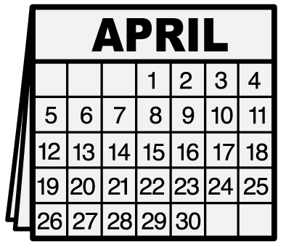
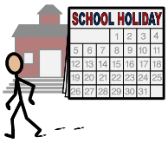
April
Monday | Tuesday | Wednesday | Thursday | Friday | Saturday | Sunday
 |  | 1 | 2 | 3 | 4 | 5
6 | 7 | 8 | 9 | 10 | 11 | 12
13 | 14 | 15 | 16 | 17 | 18 | 19
20 | 21 | 22 | 23 | 24 | 25 | 26
27 | 28 | 29 | 30

Slide 2
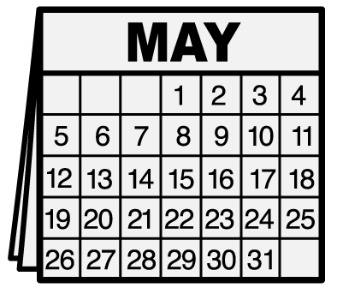
May
Monday | Tuesday | Wednesday | Thursday | Friday | Saturday | Sunday
 |  |  |  | 1 | 2 | 3
4 | 5 | 6 | 7 | 8 | 9 | 10
11 | 12 | 13 | 14 | 15 | 16 | 17
18 | 19 | 20 | 21 | 22 | 23 | 24
25 | 26 | 27 | 28 | 29 | 30 | 31

